Slide 1


Order Fulfillment Process at BlackChip SemiConductors
OPIM 5272: Business Process Modeling

Slide 2
Company Overview
Process Overview
Key Actors
AS-IS process
Gap Analysis & Enablers
To-Be process
Data Model
Database Creation
Reports
Conclusion, Future work, Recommendations
CONTENTS

Slide 3
COMPANY OVERVIEW
Semiconductors company specialized in developing low-cost hardware devices.
Supports clients that are involved in Non-Profit activities.
What we do!

Slide 4

ORDER FULFILLMENT PROCESS OVERVIEW
Typical order fulfillment at BlackChip semiconductor starts with the client placing an order and goes through several stages like sales, management, design, verification, layout planning, and silicon manufacturing.
Inter-related tasks
Trigger
Result
Gather requirements
Design Architecture
Develop Hardware
Verify Design
Plan Layout
Manufacture chip
Client Places Order
Order Fulfillment

Slide 5
KEY ACTORS
Client
Places order
Requirements
Sales
Project Manager
Assigns projects
Conduct meetings
Design
Verification
Layout
Silicon manufacture
Inventory updates
Tracking KPIs
Architecture planning
Hardware development
Testing of chips
Finding bugs
Chip planning
Manufacture chips based on order size

Slide 6
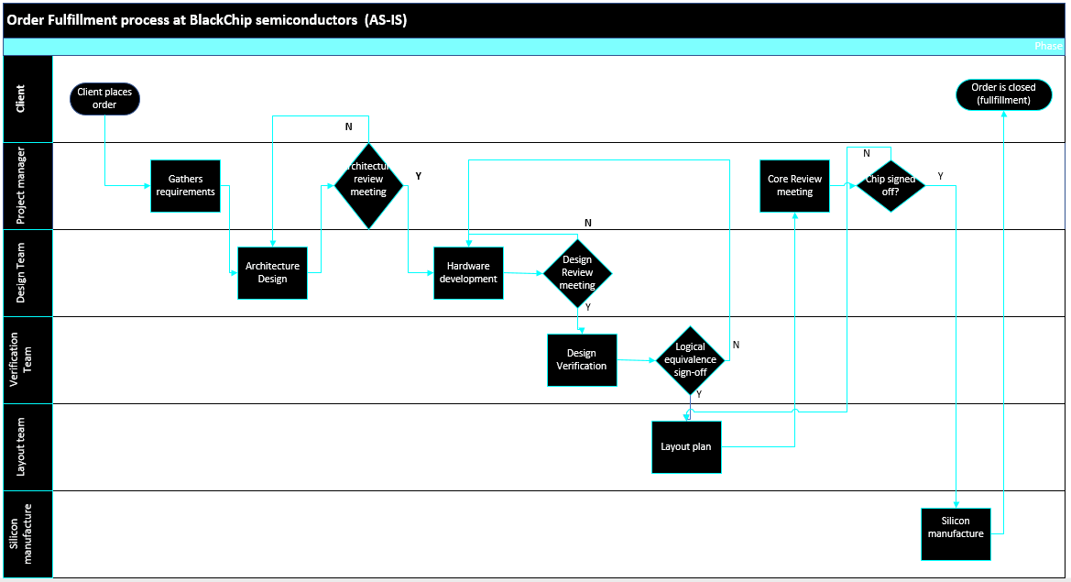

Slide 7


GAP ANALYSIS
Inadequate interaction across the Design, Verification, and Layout teams
Delay in delivery of collaterals
Resource wastage
Surge in order requests
Unable to handle concurrent orders
Unable to track KPIs
Surge in order requests
Unable to handle concurrent orders
Unable to track KPIs

Slide 8
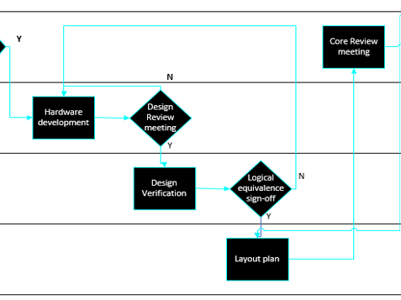
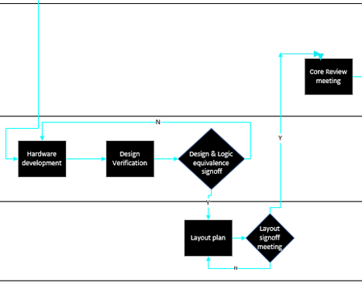
ENABLERS
Workflow Design
Combining Design & Verification actors
Adding Sales actor
Adding Layout signoff meeting
Information systems
Utilizing data generated by the sales actor for tracking KPIs
AS-IS process
TO-BE process
SALES Actor (TO-BE)

Slide 9
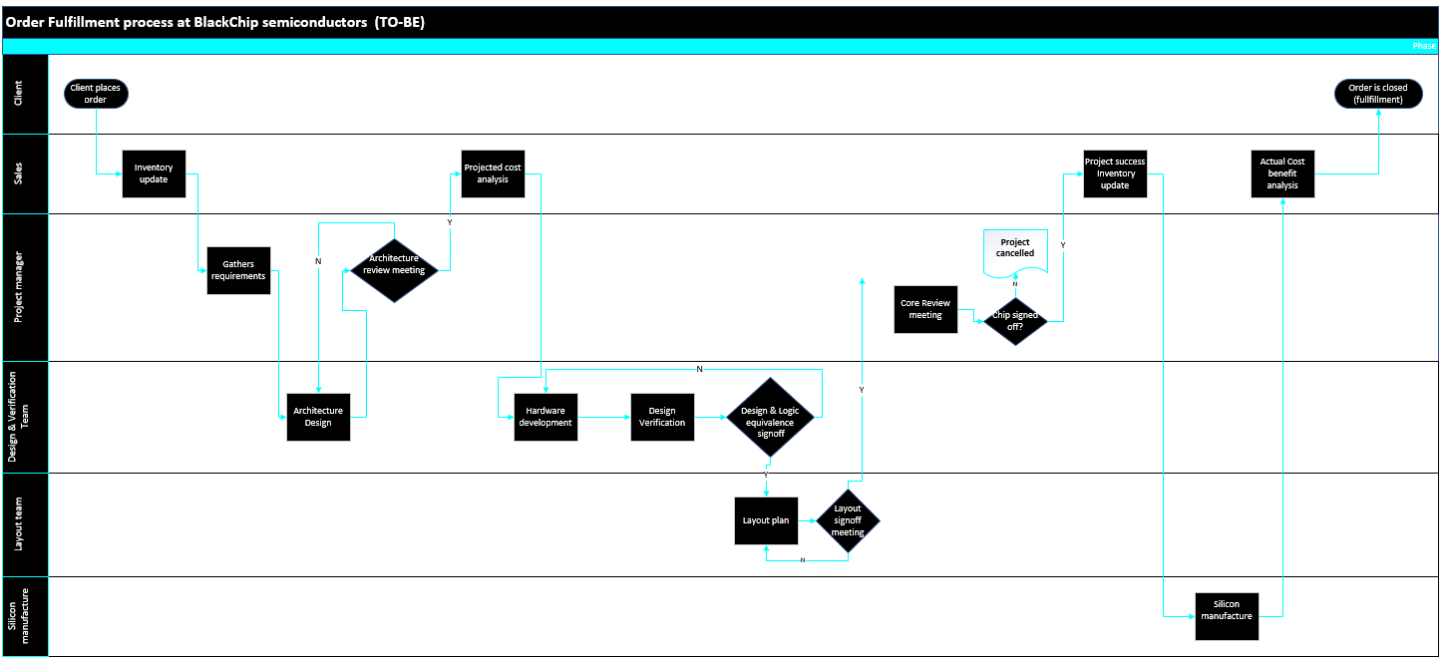

Slide 10
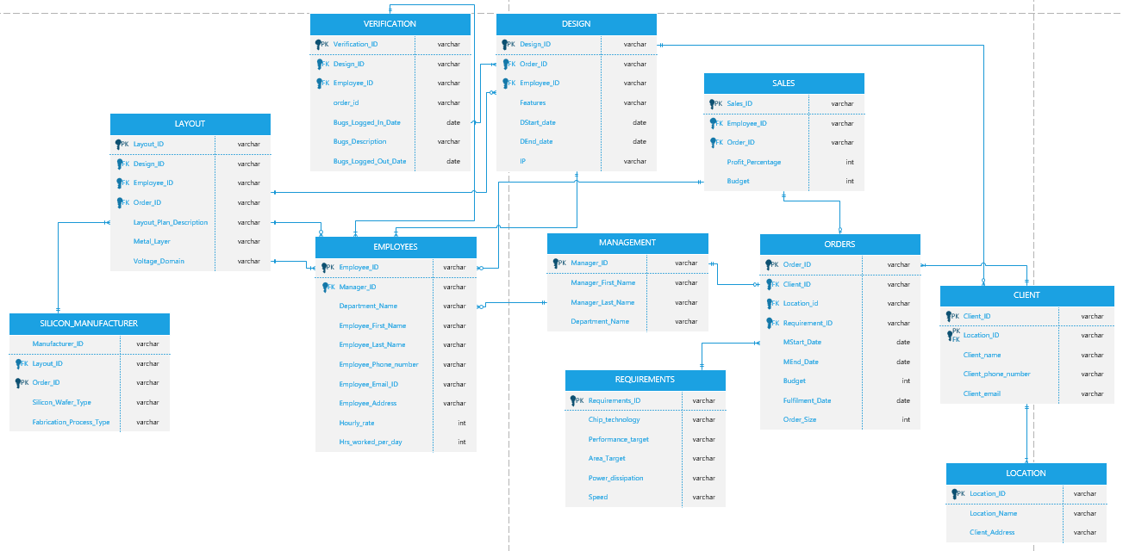
DATA MODEL

Slide 11

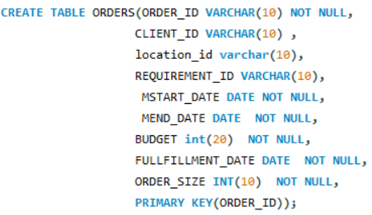
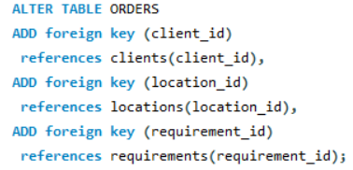
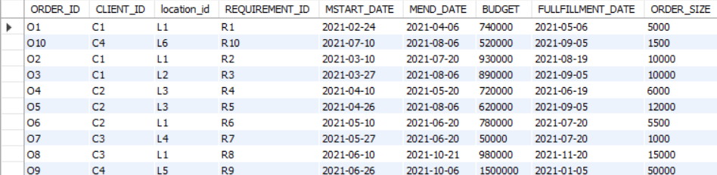
DATABASE CREATION
Table Creation:
Assigning Foreign Keys:
Order Table:

Slide 12

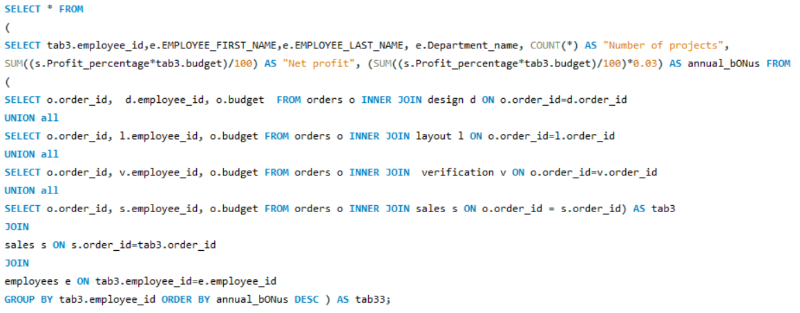
BONUS REPORT
Business Requirement:
Time has come for the HR Manager of BlackChip semiconductors to roll out the annual bonus for every employee. He has decided to set around 3% on overall profit generated by the projects worked by the employee as a bonus.
SQL Code:

Slide 13
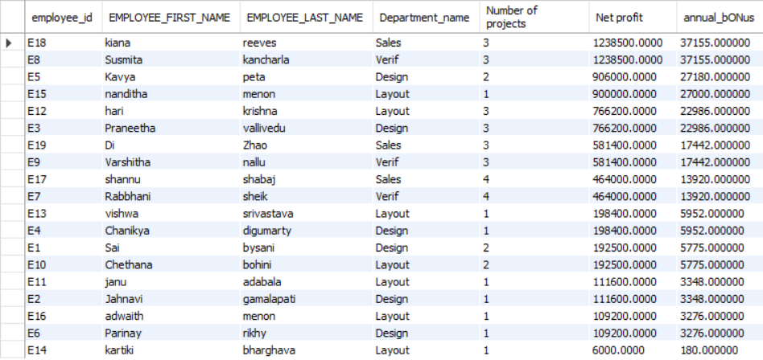
SAMPLE REPORT
SAMPLE REPORT​

Slide 14
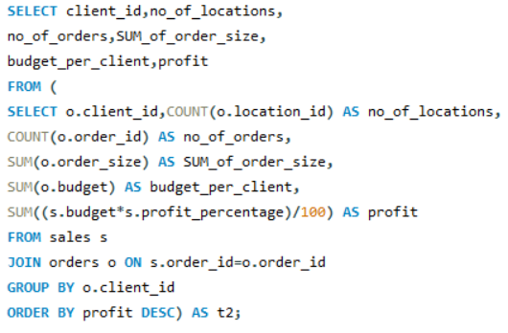
CLIENT SUMMARY REPORT
Business Requirement:
The sales team of Blackchip semiconductors company is given the task of finding high profitable clients among the existing ones.
SQL Code:

Slide 15
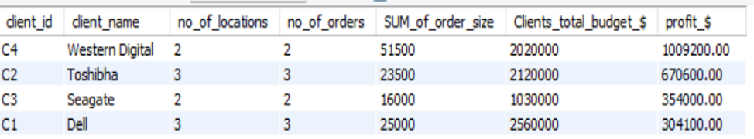
SAMPLE REPORT

Slide 16
CONCLUSION
Blackchip semi-conductors is an emerging start-up. With the changes suggested, the company was able to manage the order fulfillment process for several clients in a better way.
Optimize delivery time
Order tracking
Tracking financial targets

Slide 17
FUTURE WORK
With the increase in price of rare earth metals, we should come up a better version of present-day process, so that the company should be able to provide competitive price.
Because the number of circuits on a microchip doubles every two years, orders and sales should double as well, and the company should be able to meet the deadline.
Leveraging AI and IoT into this sector will be very beneficial.
Combining tried-and-true technology with more advanced ones in a modular package can result in new designs, improved quality, and cost savings.

Slide 18
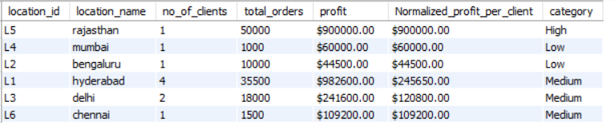
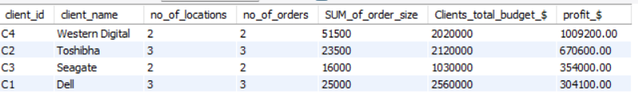
RECOMMENDATIONS
We can observe that the company only received 1000 and 1500 orders from Mumbai and Chennai. ​
Concentrating on these areas will result in increased profitability for the company. ​
We can see that the profits made from Seagate and Dell are not as high as those generated from Western Digital and Toshiba. ​
Concentrating on these clients would result in significant profits in the coming years. Also, with a smaller order size from Toshiba, they were able to get a huge profit. ​
As a result, receiving a large order from them will increase the company's revenue. ​

Slide 19
THANK YOU
Team – 2
Sai Jahnavi Gamalapati
Jahnavi Adabala
Sai Kumar Bysani
Praneetha VC

